Slide 1
have, want

Slide 2
HAVE
have

Slide 3







1
2
3
4
5

Slide 4
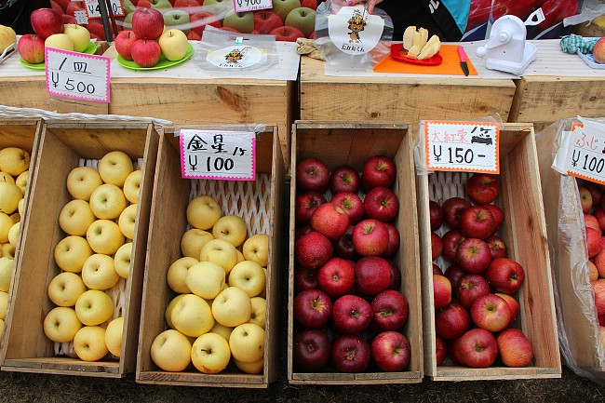
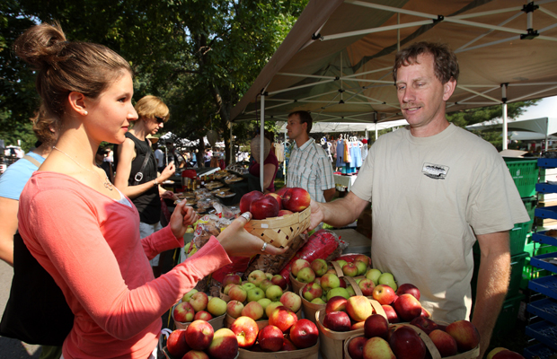
1
2
3
4
5

Slide 5
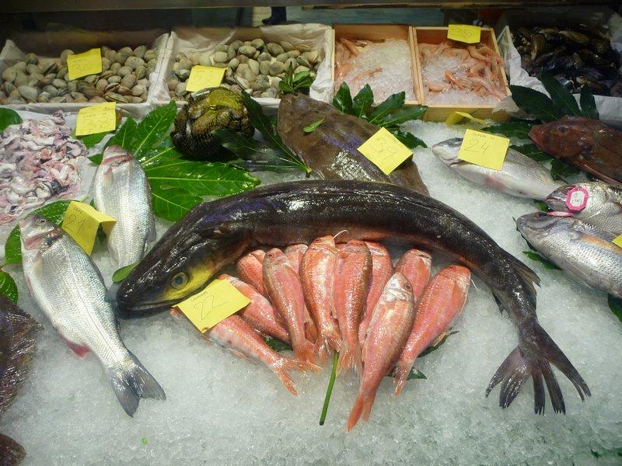

1
2
3
4
5

Slide 6


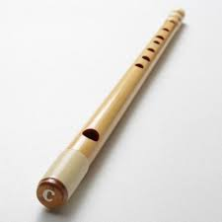

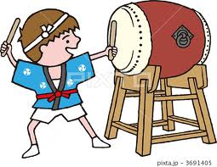

Slide 7
HAVE
have

Slide 9
WANT
want

Slide 10

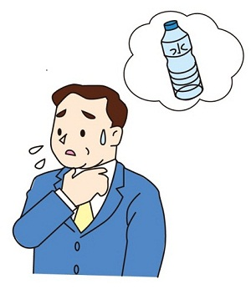
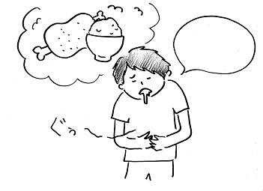
1
2
3

Slide 11
1
2
3

Slide 12
1
2
3

Slide 13
WANT
want

Slide 16
REVIEW
review

Slide 17

1
2
3
4
5

Slide 18
1
2
3

Slide 21
PRICE
price

Slide 22
HOW MUCH?
how much?

Slide 23
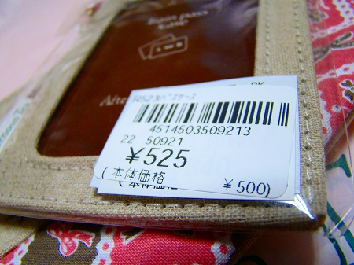
5

Slide 24
4

Slide 25
8

Slide 26
1

Slide 28







